Slide 1

Mobile App Development (MAD) Lab
News App : Flutter Project
Name : Varun Gupta
Class : D15B
Roll. No : 18

Slide 2

Content
Introduction to Project
Problem Statement
Objectives
Requirements (Hardware and Software)
Proposed Design
Implementation
Future Scope
Conclusion

Slide 3
Introduction to Project
This intuitive mobile platform is designed for everyday readers, offering a clean and organized way to stay updated with the latest headlines across various categories.
Key Features :
Category-wise news browsing (India, World, Sports, Tech).
Save-for-later functionality for future reading.
User login and profile display with personalized experience.
Article previews with images and source links.
Our app focuses on delivering a clutter-free, user-friendly experience that makes staying informed easy, efficient, and enjoyable.
r Rates

Slide 4
Problem Statement
Problem Statement is formulated as follows -
In today’s fast-paced digital age, users often find it difficult to access clean, category-wise news on a single platform. Most existing apps are cluttered with ads, have complex navigation, or prioritize sponsored content over readability. There is a need for a simple, user-friendly mobile news app that delivers focused content with features like save-for-later, easy navigation, and a smooth reading experience.
r Rates

Slide 5
Objectives of the project
Develop a Clean, User-Friendly News Platform - Build a mobile app that delivers news in an organized, clutter-free interface for a smooth reading experience.
Implement Category-Wise News Segregation - Provide users with easy navigation through categories like India, World, Sports, and Tech for focused reading.
Enable Save-for-Later Functionality - Allow users to bookmark articles for future reading, enhancing convenience and personalization.
Integrate User Authentication - Include secure login and signup features for personalized access and saved preferences.
Ensure Cross-Platform Accessibility with Flutter - Use Flutter to develop a responsive app compatible with both Android and iOS devices.

Slide 6
Requirements of the system (Hardware, software)
lem Statement
Problem Statement
Hardware Requirements | Software Requirements
Smartphone or Emulator (Android/iOS) Laptop/PC with minimum 8 GB RAM (for development) Stable Internet Connection (for Firebase integration and news updates) | Flutter SDK & Dart Android Studio / VS Code (IDE) Firebase (Authentication & Firestore) Git (for version control) Operating System: Windows/macOS/Linux

Slide 7
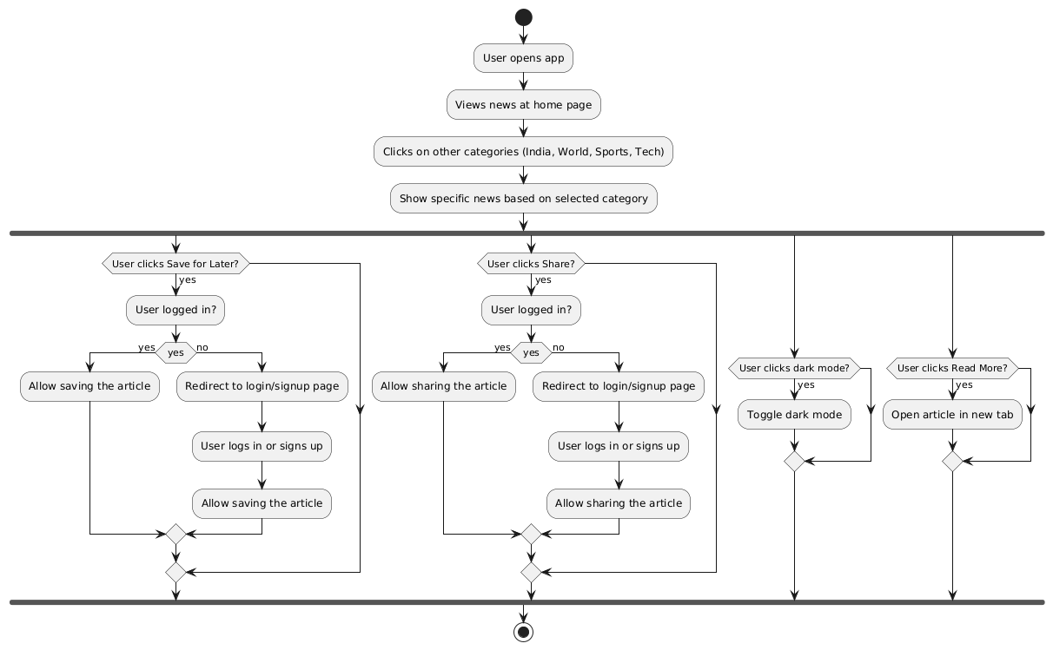
Proposed Design
Figure 1 : Flow Chart of the proposed News App

Slide 8
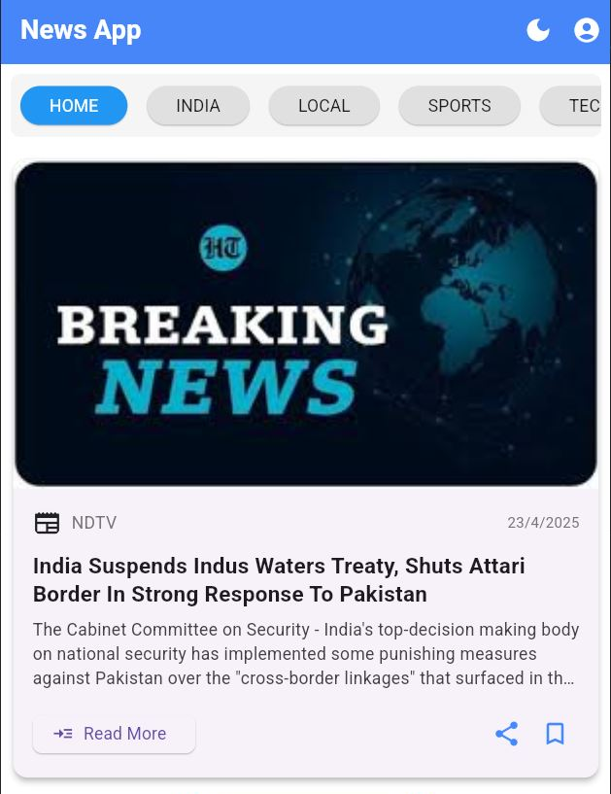
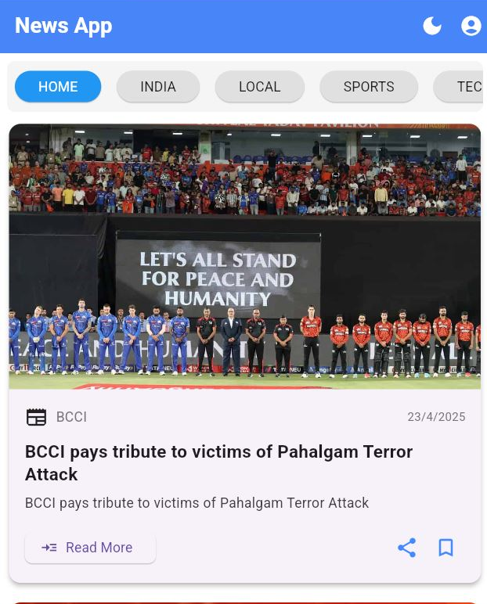
Implementation
Figure 2 : Home Page of News App

Slide 9
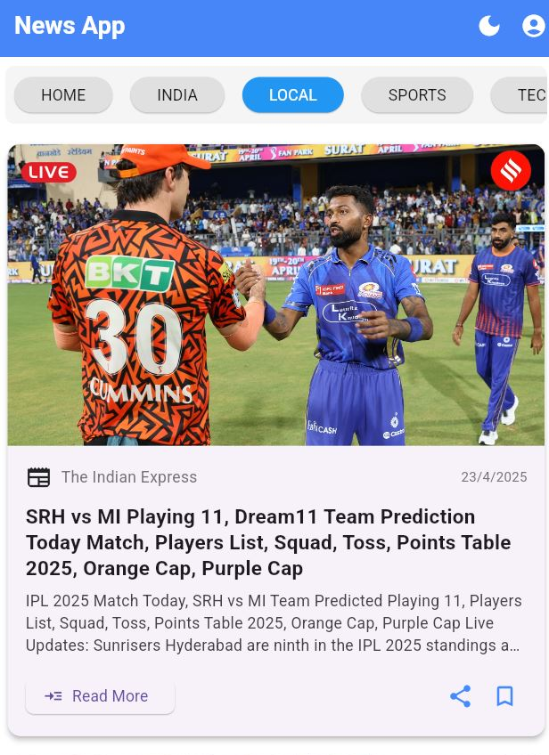
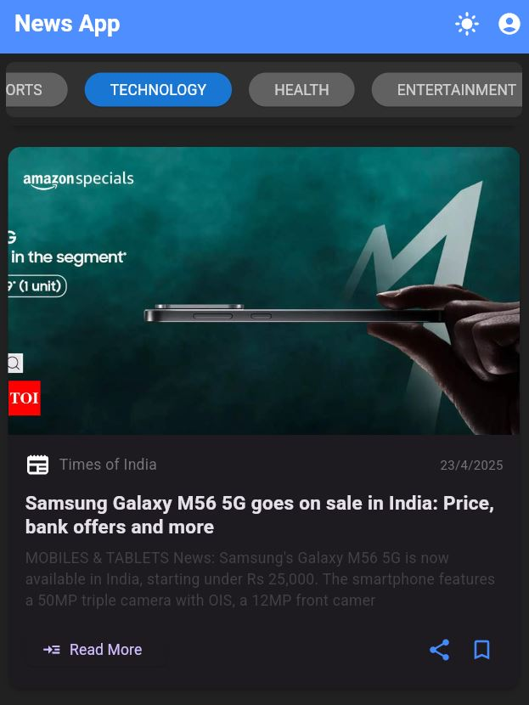
Implementation
Figure 3 : Categories and Dark Mode

Slide 10
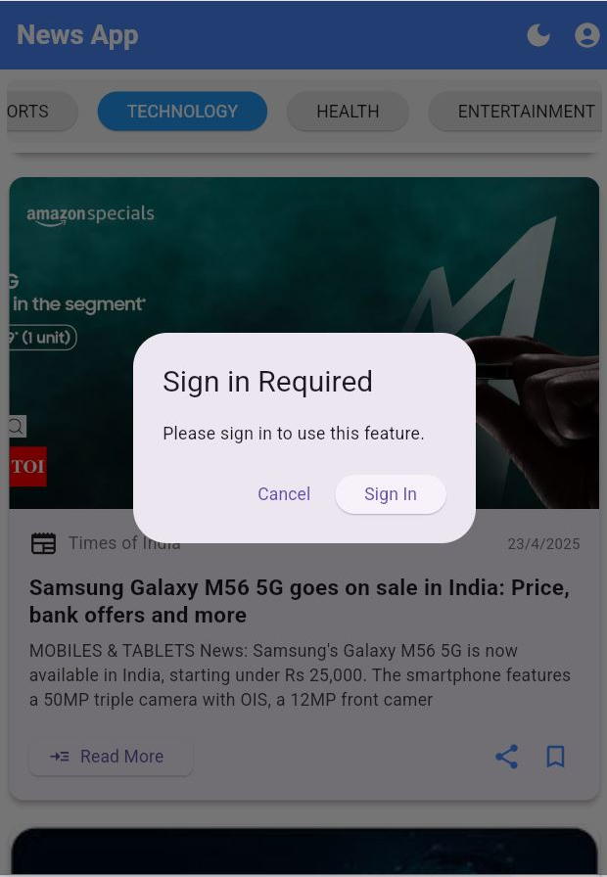
Implementation
Figure 4 : Authentication required for few features

Slide 11
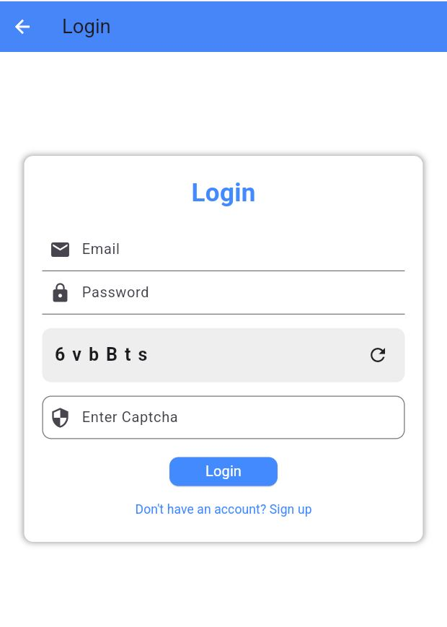
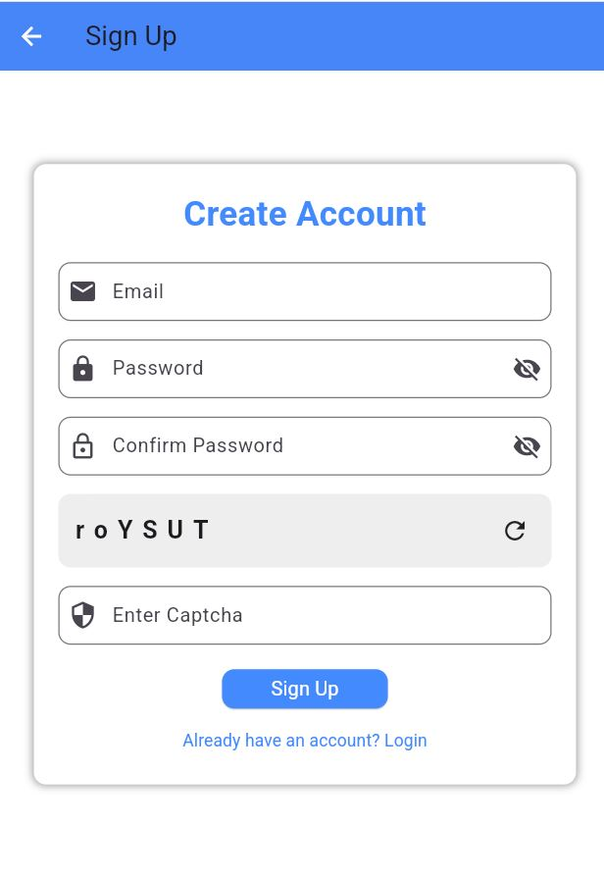
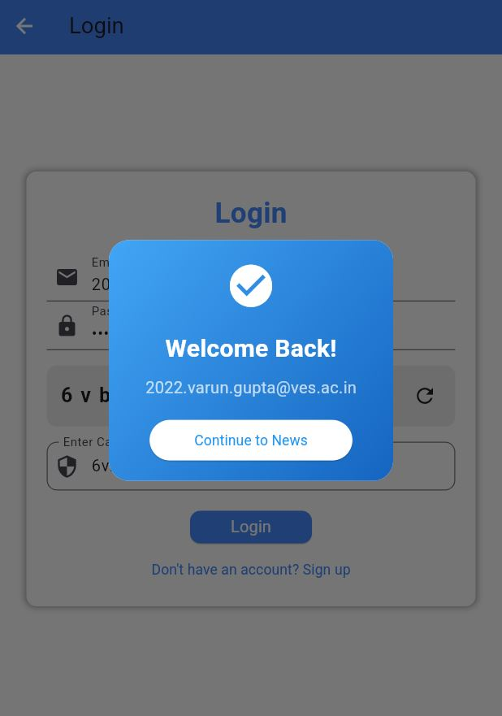
Implementation
Figure 5 : Login and Sign-up

Slide 12
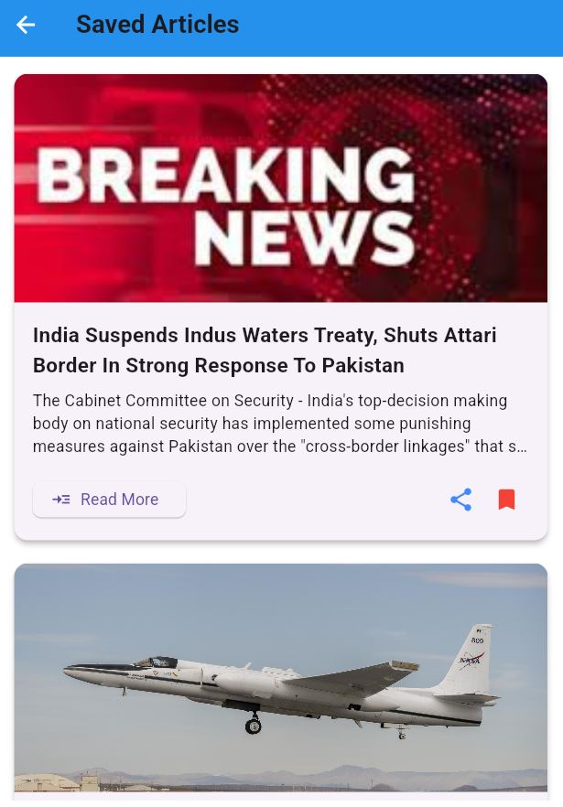
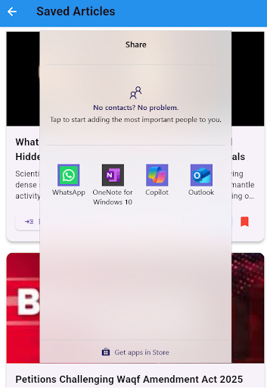
Implementation
Figure 6 : Saved Articles and Sharing Feature

Slide 13
Future Scope
Push Notifications for Breaking News Implement a push notification system to alert users about breaking news or trending stories in their preferred categories.
Multi-language Support Expand the app to support multiple languages, allowing users to read news in their preferred language, making it accessible to a wider audience.
Offline Mode for News Access Develop an offline mode to allow users to download and read articles without an active internet connection.

Slide 14
Conclusion
In conclusion, our Flutter News App marks a significant improvement in how users consume and engage with news. By integrating a clean, user-friendly interface, category-wise news segmentation, and features like Save for Later, Share, and Dark Mode, the app addresses the common challenges of cluttered and inefficient news platforms.
The app is designed to offer a seamless experience for users, enabling them to easily access news from diverse categories, share articles, and save them for future reading. We believe this platform will enhance the overall news consumption experience, providing a more personalized, efficient, and enjoyable way for users to stay informed.
Looking ahead, the app can evolve with added features like personalized news recommendations, push notifications, and offline mode, further enhancing its value for users.

